Slide 1

Fashion trends presentation
Fashion Dataset UK-US
Presented by Team 1- The Nexus League

Slide 2
About Dataset
Key Attributes
Mimic the real sales process in the fashion industry: This dataset provides valuable insights into the dynamics of the fashion market and serves as a reliable resource for analyzing sales trends, forecasting demand, and optimizing business strategies.
Collected and updated on a weekly basis: The Fashion Sales Dataset encompasses a wide range of attributes that capture the intricacies of the fashion market. It offers a realistic representation of sales transactions, customer preferences, and product characteristics, enabling researchers, analysts, and industry professionals to gain deep insights into consumer behavior and make informed decisions.
Realistic sales process
Diverse attributes - Product, Price, Brands, Style attributes,Categories, Season
Mimicked customer interaction: Feedbacks, Ratings, Reviews
Seasonal and Time variation

Slide 3

Industry Dilemma
Is there any correlation between age and the time period highest purchases?
Any correlation between the age of consumer and the influencer?
Is there any correlation between higher price products have higher rating?
Does age impact how people are influenced by social media?
Charts representing Brand Vs Customer Reviews Vs Social Media Comments Vs Feedback.
Do style attributes change as per the season? - to understand the consumer preference
Is there a correlation between the colours of clothes and the season? - to understand the consumer preference

Slide 4
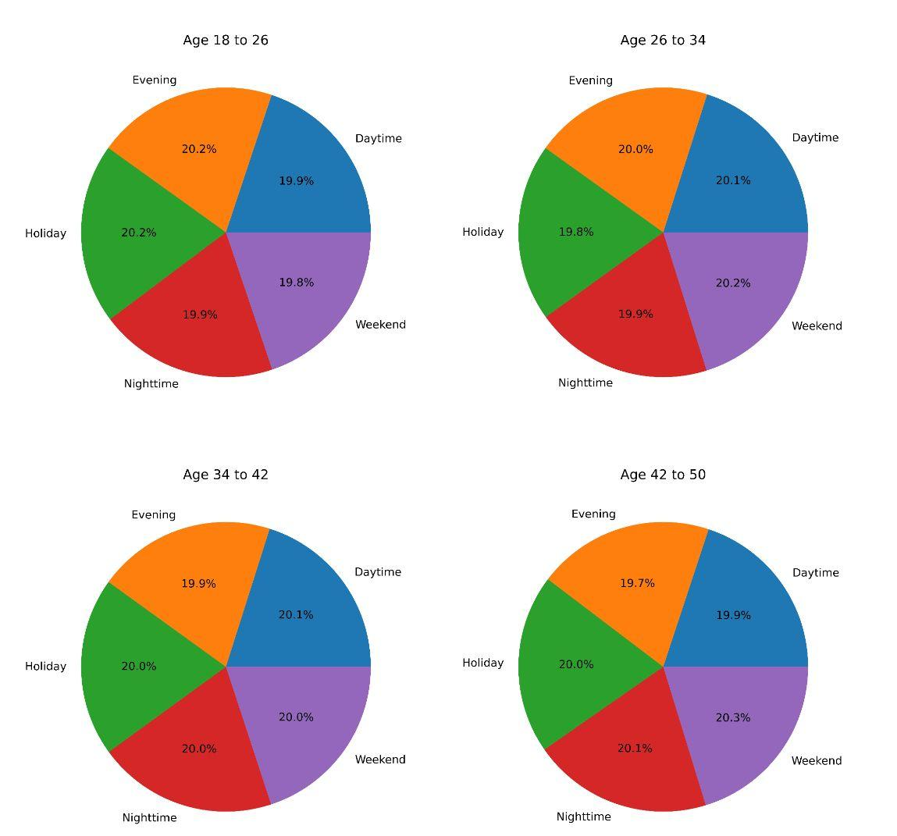
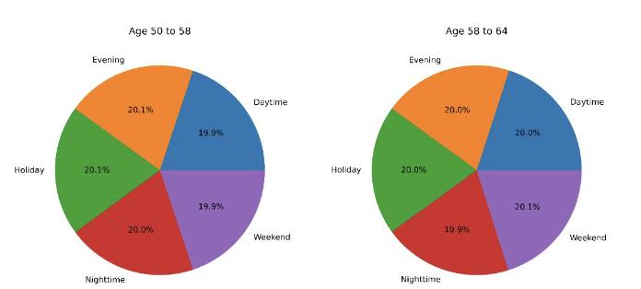
Shopping Habits Based on Age

Slide 5

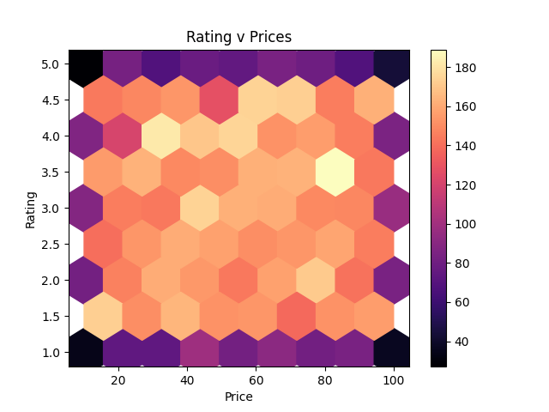

What About Relation Between Price and Rating?

Slide 6

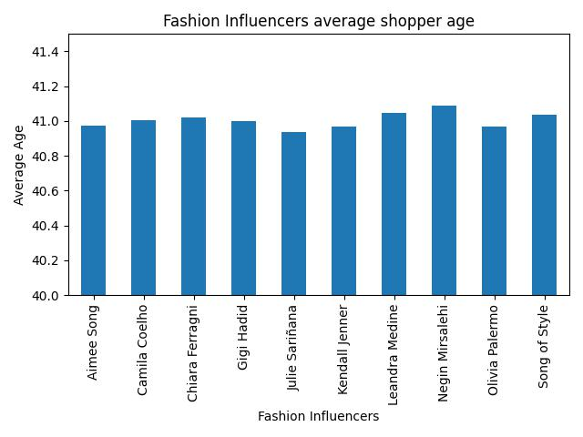
Fashion Influencers & Average Age of Shopper

Slide 7
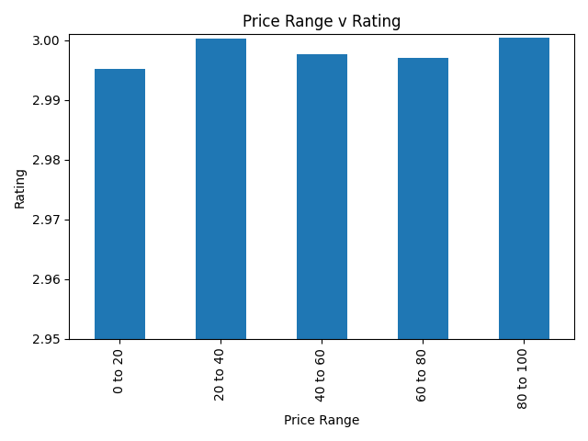
Price Relation With Rating

Slide 8
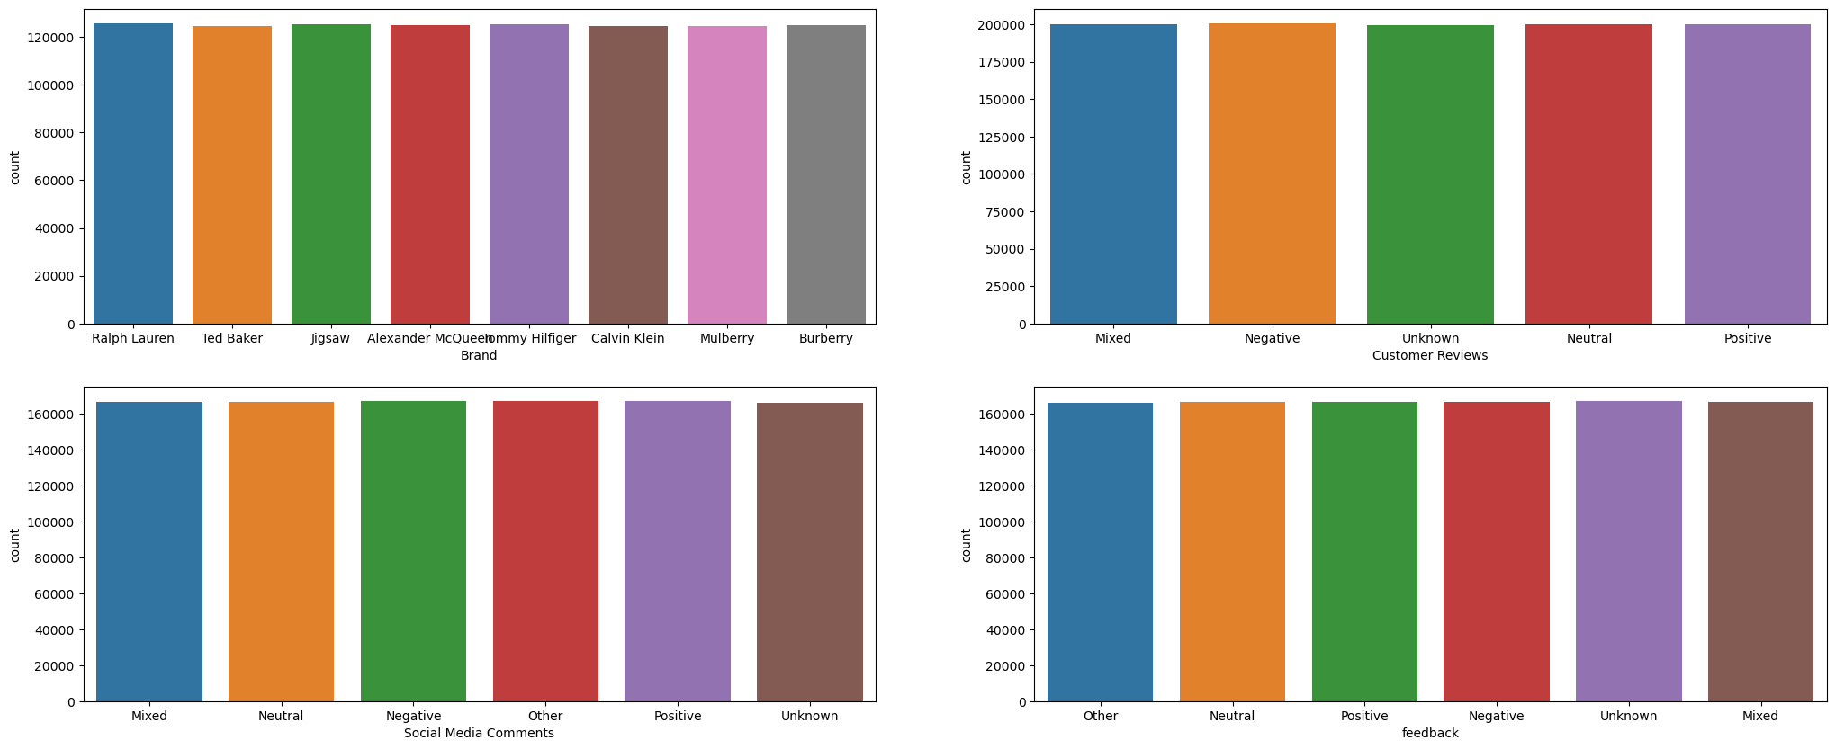
Brand vs Customer Reviews vs Social Media Comments vs Feedback

Slide 9

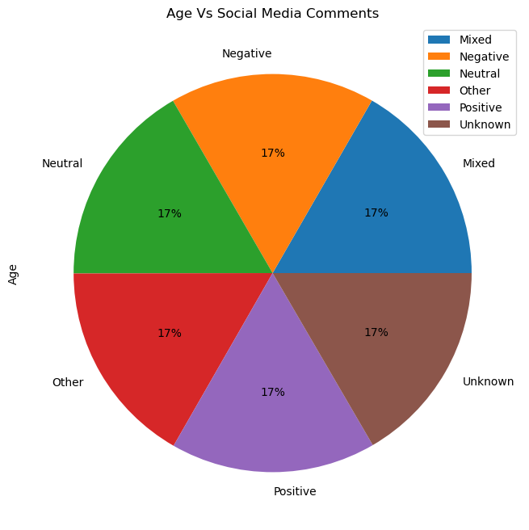

Age Vs Social Media Comments

Slide 10
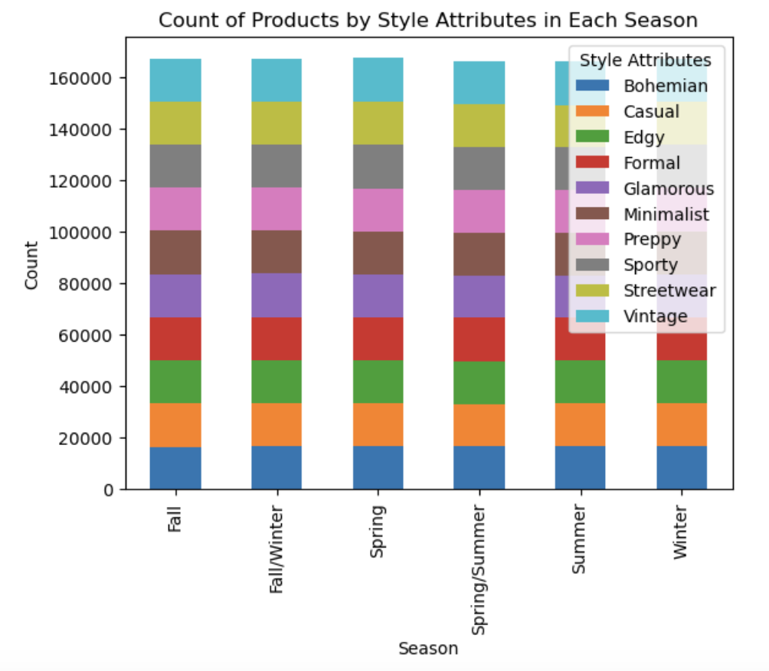
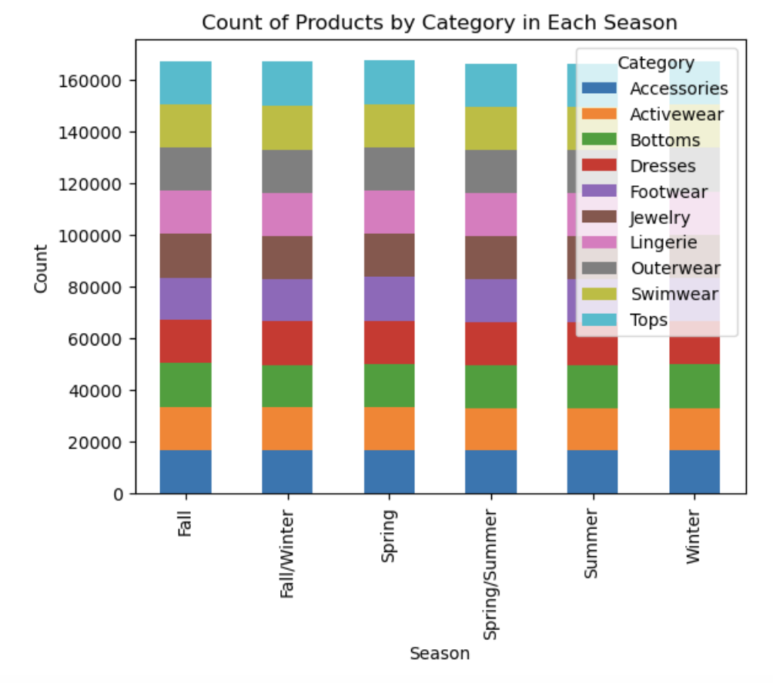
Seasonal Trends - Style Attributes & Category

Slide 11
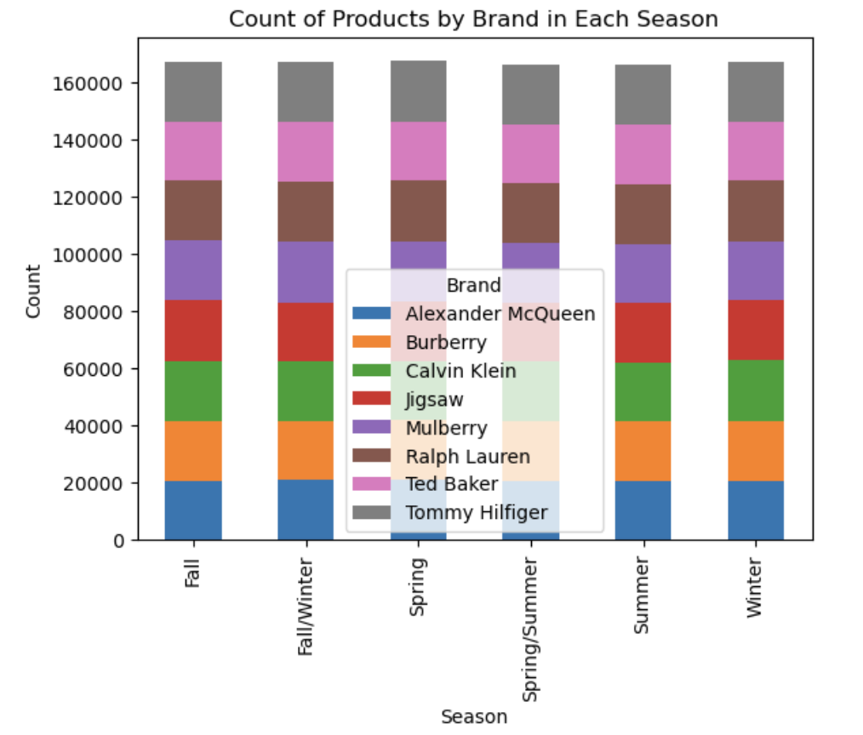
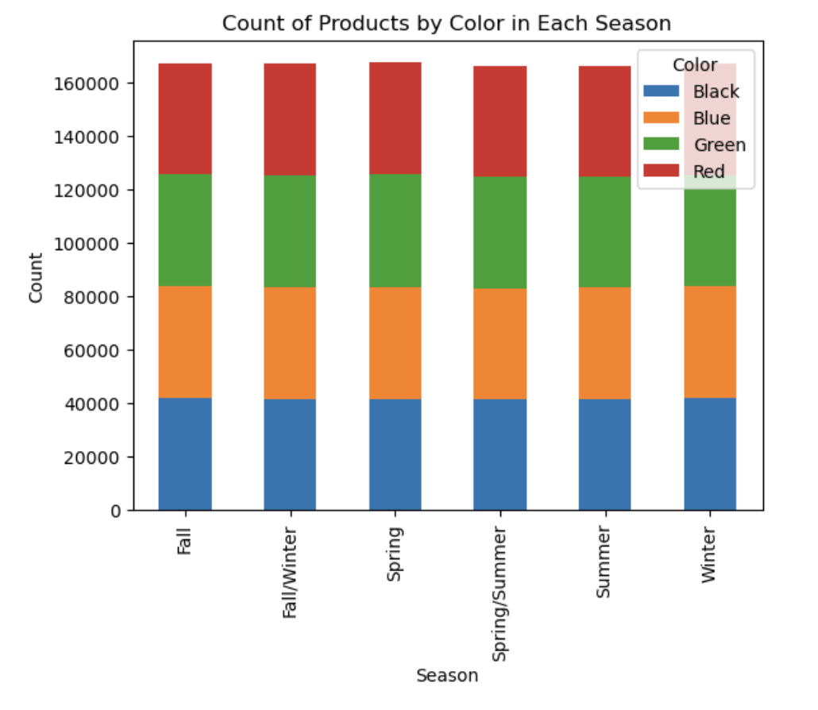
Seasonal Trends - Brand & Color

Slide 12
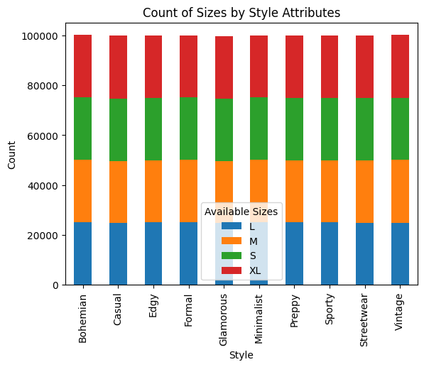
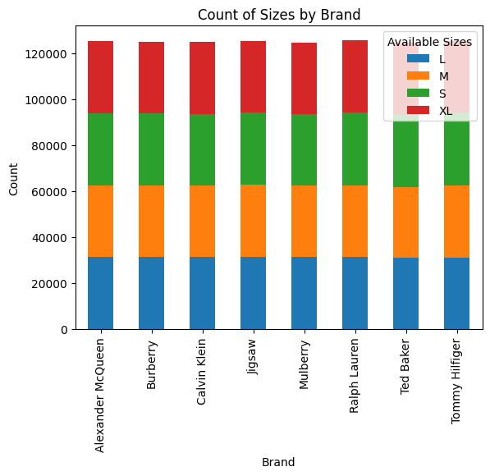
Size Trends by Style & Brand

Slide 13
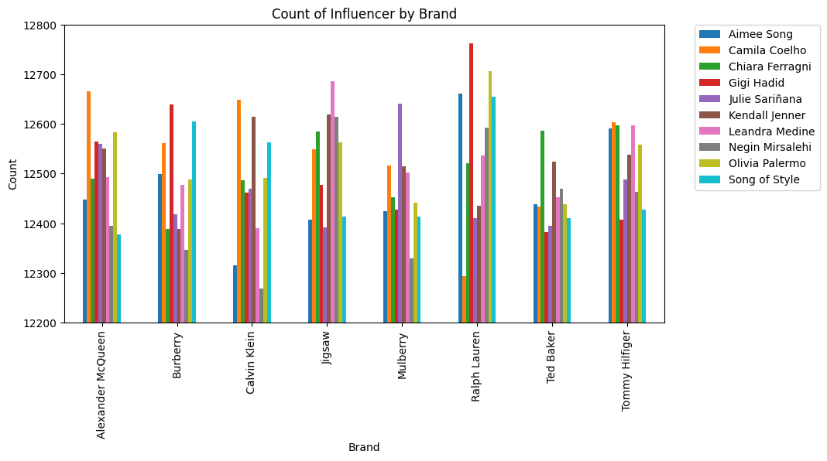
Influencer & Brand Relationship

Slide 14

CONCLUSION
Big numbers catch your audience’s attention
Limitations of Dataset:
Through all of our analysis, we found that the data was very evenly spread, which likely does not reflect what would be seen in real world fashion trends

Slide 15

Awesome words
AS A CONSUMER WE HAVE SO MUCH POWER TO CHANGE THE WORLD BY JUST BEING CAREFUL IN WHAT WE BUY
EMMA WATSON

Slide 16

Thanks
Do you have any questions?
Please keep this slide for attribution

